Slide 1
CS 2690 Computer Networks II Dr. Sayeed Sajal Lecture 11 Client Socket Calls

Slide 2
Two Areas Where Interface Standardization is Critical

Slide 3
Context of Sockets to Other Protocols and Network Services

Slide 4
Socket Concepts
A Socket is an abstraction that represents the point where a local application or process attaches to the network.
Think of it as a “handle” for network communication
Several sockets can share one network interface (adapter)
One application can use multiple sockets (servers do this)
A socket is not the same as a connection (sockets must be created on both ends before a connection can be established)
A socket is not a port in the TCP/UDP sense – but sockets and ports are related
When you need to differentiate, the Unix/Linux/macOS versions use “Berkeley Sockets”; the Windows version is “Winsock”
In the TCP/IP environment, a stream socket provides access to a TCP connection, and a datagram socket allows UDP datagrams to be sent and received

Slide 5
Stream and Datagram Socket Concept

Slide 6
Ways to Access the Windows Sockets API (Winsock)
C#: the System.Net.Sockets namespace
Java: the java.net class
Python: the socket and socketserver modules
C++: there’s no standard C++ Sockets library but several exist, including C++ Network Library, Boost (Eclipse) and ACE*
C on Windows: the #include <winsock2.h> & <ws2tcpip.h>
C on *NIX and OS X: the #include <sys/socket.h> statement
In most languages, the functions have pretty much the same names that we'll see in the C examples
In this class we’ll cover the “direct” C Winsock function calls . As noted above, many OOP languages offer socket classes that encapsulate multiple socket functions (methods), and are typically self-threading
*See https://stackoverflow.com/questions/118945/best-c-c-network-library for a longer list

Slide 7
Differences Between Berkeley Sockets and Winsock
Berkeley Sockets are available as operating system function calls
The Socket functions are built into the OS kernel (Linux, UNIX, macOS)
Windows Sockets functions are contained in a DLL
For Windows 7, 8.1 and 10, that’s ws2_32.dll
The ws2_32.dll dependency must be configured in the Visual Studio IDE
In Winsock, you must load the DLL before any Socket functions are called, and you should notify the DLL when your program terminates so that it can release Socket resources

Slide 8
Summary of Winsock TCP/Stream API Function Calls in C

Slide 9
C/C++ Header Files for Sockets
Use these header files in Windows Sockets programs coded in C or C++ (others may be required)
They go at the beginning of your program, before your main() function
#include <winsock2.h> // Winsock 2 (incl. multicast, IPv6 etc.)
#include <ws2tcpip.h>
Some or all of these may be required for Berkeley Sockets programs coded in C or C++:
#include <sys/socket.h> // Core BSD socket functions & structures
#include <arpa/inet.h> // For manipulating numeric IP addresses
#include <netinet/in.h> // IP addresses, TCP and UDP port numbers
#include <netdb.h> // For translating protocol & host names to // numeric addresses.

Slide 10
WSAStartup( )
Function prototype:
int PASCAL FAR WSAStartup(WORD wVersionRequired, LPWSADATA lpWSAData);
Sample code:
WSAStartup(MAKEWORD(2, 0), &wsaData); // Initialize Winsock DLL for v2.0
WSAStartup() returns 0 if successful, otherwise a non-zero error code. (PASCAL FAR indicates a call to a different memory segment, where arguments are pushed onto the stack in the same order they appear in the function prototype.)
wVersionRequired: the major and minor version number (2.0) of the highest Winsock version the program will support. The MAKEWORD macro (defined in winsock2.h) puts the major version number in the least significant byte (LSB) and the minor version number in the MSB.
lpWSAData: a pointer to a buffer provided by your program where the Winsock DLL will keep track of things. Declare that buffer like this before you call WSAStartup():
WSADATA wsaData; // holds details about Winsock DLL
WSAStartup() is not used with Berkeley Sockets.

Slide 11
socket( )
Function prototype:
SOCKET PASCAL FAR socket(int af, int type, int protocol);
Sample code:
int sock; // Type can also be SOCKET in Winsock, not in Berkeley Sockets
sock = socket(AF_INET6, SOCK_STREAM, IPPROTO_TCP); // Create a TCP IPv6 socket
socket() returns a 16-bit socket descriptor if successful, otherwise INVALID_SOCKET. Check the return value to verify success, call DisplayFatalErr on failure, and don’t lose the socket descriptor.
af: the address family, normally AF_INET6 for IPv6 or AF_INET for IPv4.
type: the socket type (SOCK_STREAM for TCP, SOCK_DGRAM for UDP)
protocol: the end-to-end transport protocol (IPPROTO_TCP or IPPROTO_UDP).
Most constants, such as INVALID_SOCKET and AF_INET6, are defined in winsock2.h. You won’t need to declare them in your code , as long as you use #include <winsock2.h>

Slide 12
The sockaddr_in6 and in_addr6 Structures*
// All sockets are associated with a structure like this:
struct sockaddr_in6 {
short sin6_family; // Addr type is AF_INET6 for IPv6, AF_INET for IPv4
u_short sin6_port; // Transport protocol port number
u_long sin6_flowinfo; // We won’t use this
struct in_addr6 sin6_addr; // Structure holding 16-byte IPv6 address
u_long sin6_scope_id; // Interfaces for scope, we won’t use
};
struct in_addr6 {
u_char s6_addr[16]; // Contains IPv6 address
};
*These structures are already defined for you in winsock2.h. You won’t code it yourself, you just need to declare a struct of type sockaddr_in6 (as shown on slide 11-6). Legacy IPv4 code will use sockaddr_in and in_addr instead.

Slide 13
htons( ) and inet_pton( )
htons() function prototype:
u_short WSAAPI htons(u_short hostshort);
htons() is “host-to-network short”. It converts a Windows/Intel (little endian) 16-bit integer to the Internet standard big endian format for multi-byte integers. This assumes that the port number entered on your program’s command line during execution has already been converted from char to int. Use atoi() for that.
inet_pton() function prototype:
int inet_pton(int Family, char * pszAddrString, void * pAddrBuf );
inet_pton() is ”IP address presentation to network”. It converts the host presentation (character text string) format of an address into the Internet standard 16-byte big-endian numeric format. This function can convert IP address strings from IPv4 dotted-quad and IPv6 colon hex notation. It returns 1 for success, 0 for an invalid address text string, and -1 for other errors.
Family: the address family, normally AF_INET6 for IPv6 or AF_INET for IPv4.
pszAddrString: null terminated text string in IPv6 or IPv4 standard form.
pAddrBuf: field of appropriate size to store address in Internet standard 16-byte form (possibly in sockaddr_in6).

Slide 14
Converting the Port Number to Internet Format
Port number entered on command line as text characters
(data type *char, a NULL terminated C string):
‘1’
‘2’
‘3’
‘4’
‘\0’
Converted by atoi() from char to equivalent 16-bit
unsigned integer (data type unsigned short). Stored
in Windows’ native little-endian format (shown in hex):
d 2
0 4
Converted by htons() from little-endian to big endian
16-bit unsigned integer (data type unchanged). Stored in
standard integer format, as required by most Internet
protocols:
0 4
d 2

Slide 15
Populating sockaddr_in6 with Server Info
Sample command line: WSEchoClientv6.exe <server addr> <server port> <"Message">
Sample code:
// Declare structure and variables
struct sockaddr_in6 serverInfo; // client’s IPv6 structure for server info
// Server IP address and port number come from the client command line
char *serverIPaddr; // ptr to char string holding IPv6 address
unsigned short serverPort; // 16-bit int port number on server
// Begin procedural code
memset(&serverInfo, 0, sizeof(serverInfo)); // zero out the structure
// Load server info into sockaddr_in6
serverInfo.sin6_family = AF_INET6; // address family = IPv6
serverInfo.sin6_port = htons(serverPort); // convert int port to ntwk order*
// Convert cmd line server addr from char to ntwk form, load into sockaddr_in6
inet_pton(AF_INET6, serverIPaddr, &serverInfo.sin6_addr)
*Server port command line argument is a text string. Pass that to atoi() to convert to int before passing the int to htons(). See slide 12-3 for atoi() code example.

Slide 16
connect( )
Function prototype:
int PASCAL FAR connect(SOCKET s, struct sockaddr FAR *addr, int namelen);
Sample code:
// The DisplayFatalErr() function uses info from lpWSAData, so don’t
// call it until after the Winsock DLL is loaded.
if (connect(sock, (struct sockaddr *) &serverInfo, sizeof(serverInfo)) < 0)
DisplayFatalErr("connect() function failed.");
connect() is normally used only by the client. It is a blocking call which does not return until the TCP connection has been established (SYN, SYN+ACK, ACK), or the connection request fails. There are many ways connect() can fail, so always check the return value as shown above. A return value of 0 indicates the connection is established. A negative return value indicates failure. See https://msdn.microsoft.com/en-us/library/aa923167.aspx for the various error return codes.
s: the handle of a previously created socket (“sock” on slide 11-11)
addr: a pointer to the socket address structure. Because the Sockets API is generic, a pointer to the sockaddr_in structure must be cast to the generic type sockaddr, and the actual length of the address structure must be provided (see namelen below). For TCP and UDP sockets using IPv6, the actual structure type is normally sockaddr_in6, as shown on the previous slides.
namelen: the length of the structure pointed to by addr. For convenience, use the C sizeof() operator to obtain this value, as shown above.

Slide 17
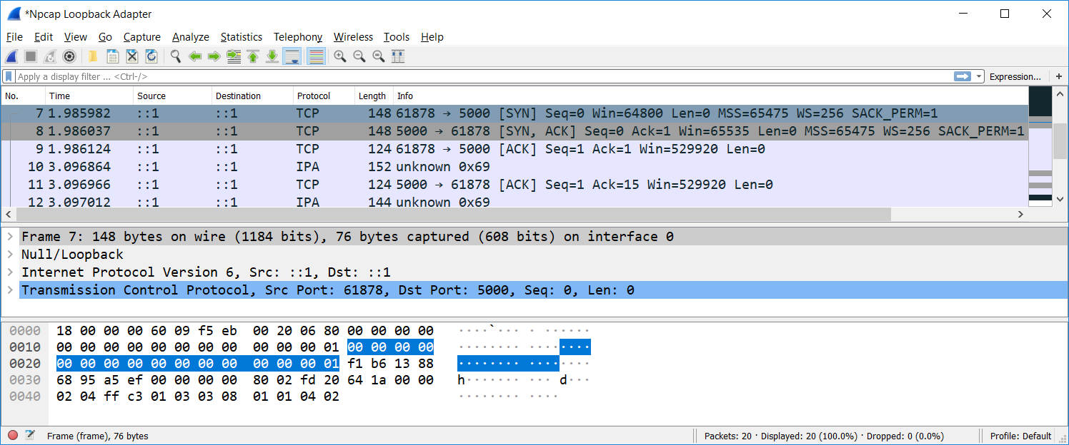
TCP Messages Transmitted When connect( ) is Called*
*TCP client and server in loopback mode (IPv6 address = ::1), captured with Wireshark using the Npcap driver.

Slide 18
send( )
Function prototype:
int PASCAL FAR send(SOCKET s, const char FAR *buf, int len, int flags);
Sample code:
if (send(sock, msg, msgLen, 0) != msgLen) // send() returns # bytes sent
// Display error message or send the rest with more send() calls
send() is one of several functions that can be used by connection-oriented (TCP) client or server to transmit data. With a TCP connection, send() returns when at least some data has been transferred “down” from the application’s buffer to the local protocol stack’s send buffer. The return value is the number of bytes actually transferred, or SOCKET_ERROR (-1) if it fails. TCP doesn’t understand text string or other data type semantics, it just sends bytes. Successful return does not mean that the data has been received at the destination, or even that data has been transmitted onto the network. send() will fail if a connection is not established for the referenced socket, or if that connection has failed or closed normally in the meantime. With a TCP socket, send() may provide a successful return value even when the number of bytes transmitted is less than what was requested. It is the application’s responsibility to call send() as many times as required, until all application data has been sent.
s: the socket handle for the previously established connection
buf: a pointer to the first byte of data in a buffer containing data for transmission
len: the number of bytes to be sent (in Program 1, don’t count the string’s null terminator)
flags: rarely-used flags that control the send (normally set to 0).

Slide 19
recv( )
Function prototype:
int PASCAL FAR recv(SOCKET s, char FAR *buf, int len, int flags);
Sample code:
if ((bytesRead = recv(sock, rcvBuffer, RCVBUFSZ - 1, 0)) <= 0)
// Display error message
recv() is generally similar to send(), and is typically used by connection-oriented (TCP) clients and servers. Only data from the IP address and port number associated with the referenced socket will be accepted. Data from other sources will be filtered (ignored). The normal return value is number of bytes returned to the application’s receive buffer (rcvBuffer), which may be less than the size of that buffer. In general, a return code of -1 indicates some kind of receive failure, and 0 indicates that the connection has been closed by the other side. recv() will block until at least some data is received, an error occurs, or the connection is closed. Because all data transmitted by the sender may not be received in one TCP segment, recv() is normally called repeatedly until all data has been received.
s: the socket handle for a previously established connection
buf: a pointer to a buffer big enough to accept the received data. Receive buffers should be character arrays, for example: char rcvBuf[BUFSIZ];
len: overall length of the receive buffer in bytes. (The example above leaves one byte empty in the buffer to allow for a string terminator character (\0) to be inserted for display purposes.)
flags: normally set to 0. See https://docs.microsoft.com/en-us/windows/desktop/api/winsock/nf-winsock-recv for some options.

Slide 20
closesocket( )
Function prototype:
int PASCAL FAR closesocket(SOCKET s);
Sample code:
closesocket(sock);
Either side can begin closing a Windows TCP connection by calling closesocket(), which is non-blocking by default. closesocket() will transmit a TCP FIN and initiate the standard “graceful” close. It returns 0 on success, which is likely but not guaranteed. Both client and server should call closesocket() to release socket resources. If you need to do a different type of close (like an abort), use the shutdown() function instead. For Berkeley Sockets, use close() in place of closesocket().
s: socket handle to be closed

Slide 21
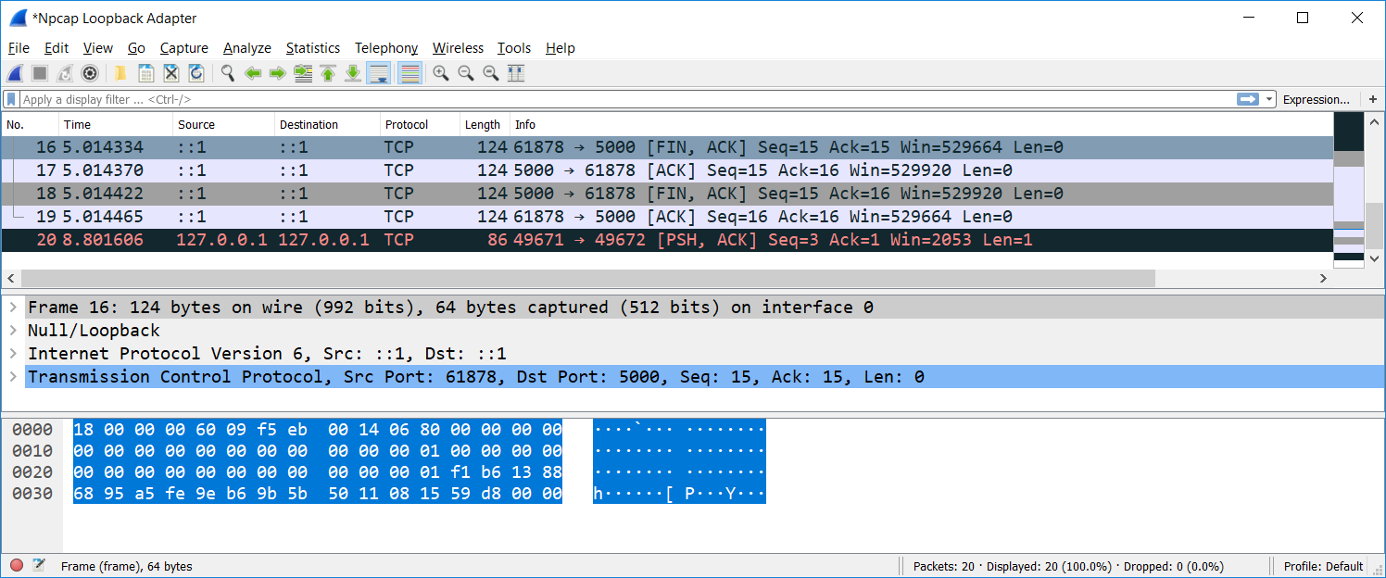
TCP Messages Transmitted When closesocket( ) is Called*
*Either side can start the close. In this case, the client calls closesocket( ) first.

Slide 22
WSACleanup( )
Function prototype:
int PASCAL FAR WSACleanup();
Sample code:
WSACleanup();
This frees Winsock DLL resources when no longer needed. Any application that calls WSAStartup() must also call WSACleanup(), unless WSAStartup() fails. WSACleanup() returns immediately with a return code of 0 if successful. WSACleanup() will not cancel pending blocking calls and it may not close outstanding sockets. Therefore, before calling WSACleanup(), you should:
Cancel any outstanding blocking operation with WSACancelBlockingCall()
Close all open sockets with a successful call to closesocket()
WSACleanup() is not used with Berkeley Sockets.

Slide 23
Summary of Winsock TCP/Stream API Calls

